Slide 1

Research on the Identification of breakthrough technologies driven by science
Authors: Dan Wang, Xiao Zhou, Pengwei Zhao, Juan Pang, and Qiaoyang Ren
Xidian University

Slide 2
01/ Introduction
02/ Research framework
CONTANTS
03/ Results and Analysis
04/ Conclusion

Slide 3

Part One
Introduction

Slide 4

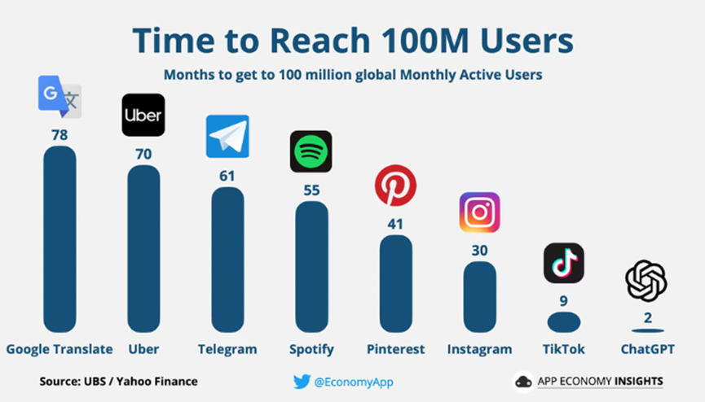
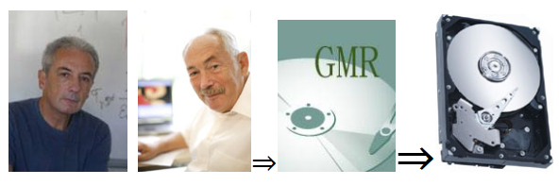
Introduction
Research framework
Results and analysis
Conclusion
Research background
As a highly discontinuous type of innovation, breakthrough technologies have the potential to change the current status among competition while creating new economic opportunities and affecting societies and the lives of people.
New science not only as a catalyst for scientific progress but also as the key driving force behind technological breakthroughs.
2007 Nobel Prize Honors GMR Discovery

Slide 5

Introduction
Research framework
Results and analysis
Conclusion
Characterization of technical knowledge
Using coarse-grained single patent or International Patent Classification (IPC) number to characterize technical knowledge.
Using keywords and key phrases as the fundamental units of knowledge elements, innovatively recombining to represent technical knowledge.
Characterization of breakthrough technologies
Our study characterizes breakthrough technologies as a combination of interconnected new science and technology topics.
Research question
How does the dynamic evolution process, guided by the S-T innovation pattern, lead to technological breakthroughs through the influence of new science, thereby identifying breakthrough technologies?

Slide 6
Part Two
Research framework

Slide 7
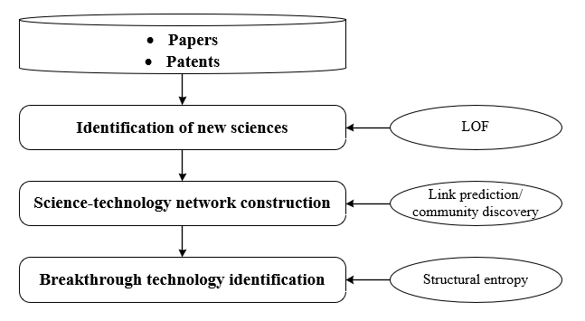
Introduction
Research framework
Results and analysis
Conclusion
To deeply depict the dynamic evolution process of breakthrough technologies triggered by new science, this paper proposes a framework for identifying breakthrough technologies:

Slide 8
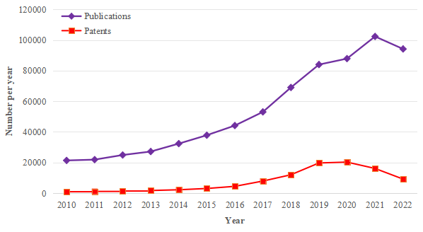
Introduction
Research framework
Results and analysis
Conclusion
(1) Data collection
Scientific publications and patents are viewed as respective proxies of scientific research and technological advance. We employ artificial intelligence (AI) technologies as a case study, specifically within the timeframe from 2014 to 2018.

Slide 9
Introduction
Research framework
Results and analysis
Conclusion
(2) Preprocessing
New sciences are defined as scientific topics with novelty and impact that have not yet been integrated into the existing technology system.
A science-technology network among new sciences and patents is constructed. This network describes the flow of knowledge from new sciences to technology.
Link prediction is employed to explore the deep fusion semantic links between new sciences and technology.
The community discovery algorithm is utilized to identify and filter subnetworks containing new links between new sciences and technologies.
structural entropy is employed to evaluate the influence of subnetworks, thereby identifying breakthrough technologies.

Slide 10
Part Three
Results and analysis

Slide 11
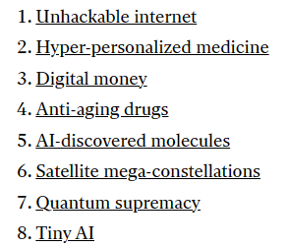
Introduction
Research framework
Results and analysis
Conclusion
Case study: AI
The analysis resulted in 13 subnetworks, 11 of which contain new links. The table displays the influence of these subnetworks.
Using the median as a threshold, five subnetworks exceeding this value were identified as potential breakthrough technologies. Among them, the impact of drug discovery, as the 12th technology, is particularly significant.
Validity evaluation
Expert opinions.
Authoritative journals. (#12 drug discovery)
subnetwork | new_structural entyopy | original_structural entyopy | Subnetwork_Impact
12 | -19.33 | -24.10 | 4.77
1 | -25.28 | -24.10 | 1.18
10 | -22.97 | -24.10 | 1.13
11 | -25.20 | -24.10 | 1.10
9 | -25.13 | -24.10 | 1.03
5 | -23.09 | -24.10 | 1.01
2 | -24.85 | -24.10 | 0.75
4 | -23.55 | -24.10 | 0.55
6 | -23.94 | -24.10 | 0.16
0 | -23.97 | -24.10 | 0.13
3 | -24.03 | -24.10 | 0.07
MIT Technology Review (2020)
...

Slide 12
Part Four
Conclusion

Slide 13
Introduction
Research framework
Results and analysis
Conclusion
Implications
This paper proposes a novel method for identifying breakthrough technologies based on the innovation pattern of science-driven technology.
Employing a topic-based fine-grained approach, the paper tracks the dynamic interaction trajectories between new science and technology at the semantic level.
Employing papers and patent data from the AI field, we pinpointed five breakthrough technologies, thus validating the effectiveness of the method.
Limitations
This paper mainly considers the driving effect of science on technology. In future research, breakthrough technology identification under different patterns of S&T interaction can be considered.
Moreover, beyond scientific factors, incorporating various types of sources such as commercial impetus may become an important direction for identifying breakthrough technologies in the future.

Slide 14
THANK YOU
Authors: Dan Wang, Xiao Zhou, Pengwei Zhao, Juan Pang, and Qiaoyang Ren
Xidian University

